Slide 1
Lecture 2: Optimization methods

Slide 2
Overview
Introduction
Mathematical formulation
One-dimensional minimization
Newton’s Method
Conjugate gradient method

Slide 3


Introduction
Optimization is used everywhere in nature:
Physics
Chemistry
Economics
Engineering
Etc…
and of course STATISTICS!

Slide 4

Introduction
Example 1: Industry
How to produce a cylindrical beer can 0.5L so it requires minimum material?
Continuous optimization

Slide 5
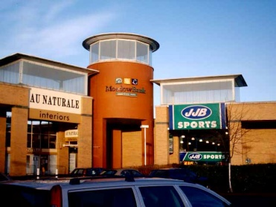

Introduction
Example 2: Economics
Factories F1, F2
Retail outlets R1, R2, R3
Cost of shipping a product c_{ij}
Production a_{i} each week
Requirement b_{j} each week
F1
F2
Network flow optimization

Slide 6
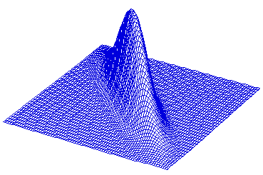
Introduction
Example 3: Statistics
Maximize Likelihood L(X, θ)
Almost all model fitting requires optimization!

Slide 7
Maximum likelihood
Consider a sample (X₁, ..., X_{n}) which is drawn from a probability distribution P(X|Θ) where Θ are parameters.
If the Xs are independent with probability density function P(X_{i}|Θ) then the joint probability of the whole set is
Find the parameters that maximize this function
Consider a sample (X₁, ..., X_{n}) which is drawn from a probability distribution P(X|A) where A are parameters.
If the Xs are independent with probability density function P(X_{i}|A) the joint probability of the whole set is

Slide 8
Mathematical formulation
We need to minimize or maximize
Objective function f(x) (I - cost, II - profit, III-likelihood)
dependent on
Parameters or Unknowns x (I-height & diameter, II- supply, III – parameters

Slide 9
Mathematical formulation
Sometimes we have constraints c_{i}(x) satisfying equations or inequalities. Formulation:
What if:
Max instead of min
Constraints are not like these

Slide 10
Mathematical formulation
Example 1: Constraints – volume=0.5L
Example 2- cont.
Example 3 – no constraints UNCONSTRAINED MINIMIZATION

Slide 11
Exercise
Split into groups of three-four and
Find an application when optimization is needed (your personal experience, research, university courses)
State your problem
Objective function
Parameters
Constraints if any
You have max 10 minutes

Slide 12
Where we are
Why different algorithms?
Speed
Memory
Historically
Unconstrained
Optimization
Constrained
Steepest descent
Newton method
Quasi-Newton-Methods
Conjugate gradients

Slide 13
One-dimensional minimization
One-dimensional minimization=one parameter
Algorithm Golden Section: finds local minimum on interval [A,B]
It narrows down the search interval, constant reduction factor 1-α=(√5 -1 )/2≈0.62

Slide 14
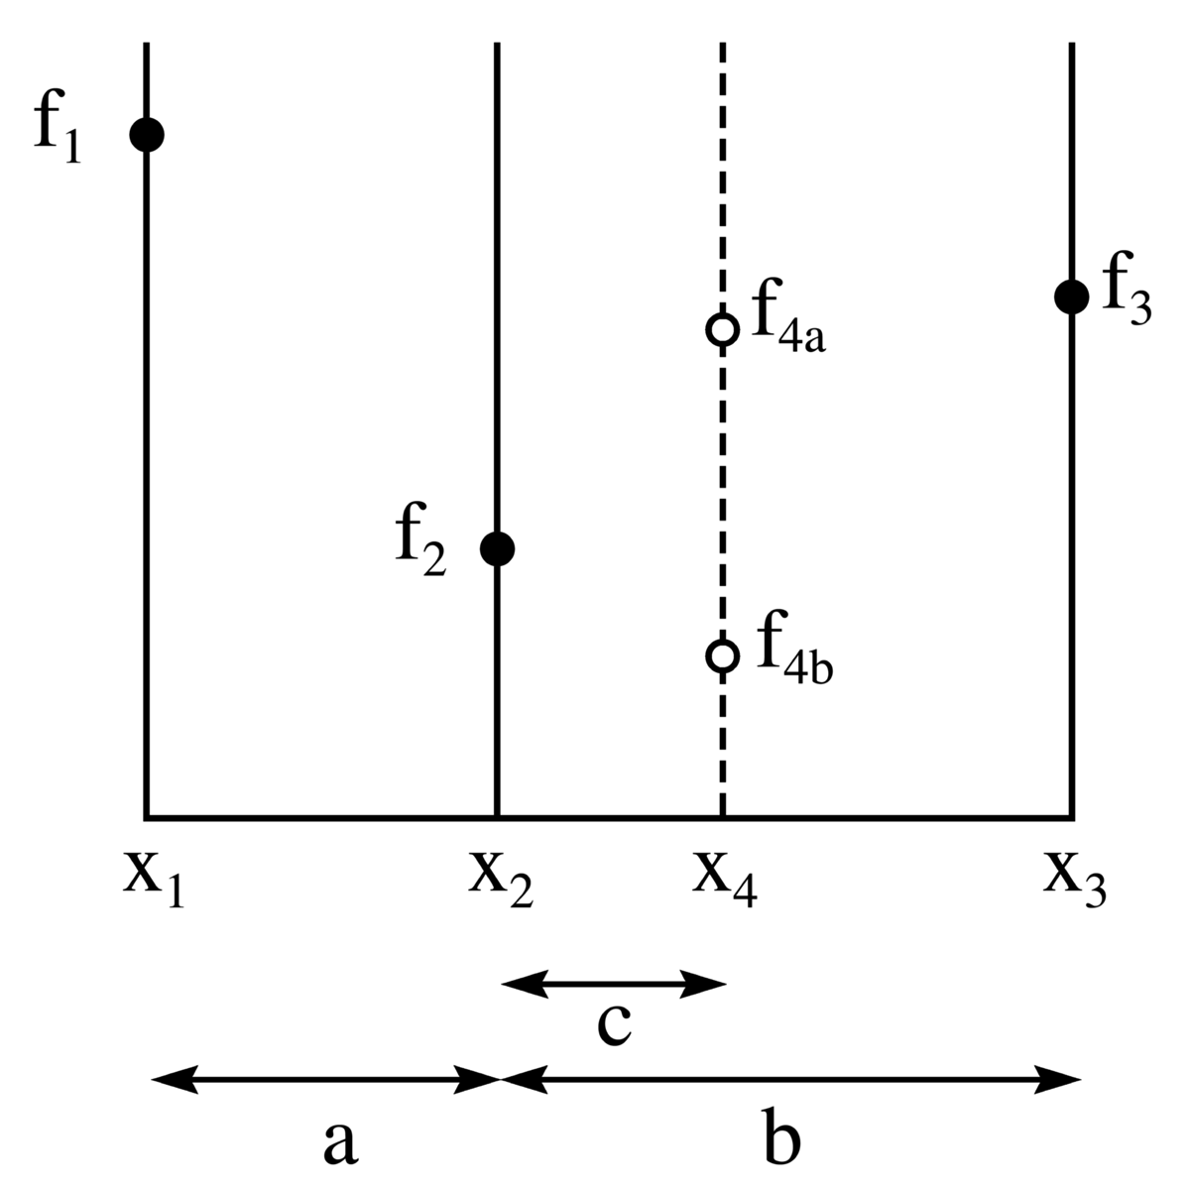
One-dimensional minimization
Golden section
Choose interval [x₁, x₃]
Choose a=α(x₃ – x₁)
x₂=x₁+a, x₄=x₃-a
If f₄>f₂ select RED
If f₄<f₂ select BLUE
Continue with new interval until it is small
_{Note: f should be unimodal}

Slide 15
R: One-dimensional minimization
Brent’s method – improved golden search
optimize(f, interval,...)

Slide 16
Multidimensional optimization
General methodology:
Given starting point x₀, x=x₀
Choose direction p and step α
Move to x:=x+ α p
Repeat from 2 until convergence
The problem:
Gradient
Hessian

Slide 17
Multidimensional optimization
How to choose direction leading to function decrease ?
Taylor theorem
The minimum is
Any direction having is descent direction
Should be minimized

Slide 18
Multidimensional optimization
How to choose step size α?
Find global minimum along direction p (expensive)
Find a sufficient decrease
BACKTRACKING
Choose α₀ >0, ρ in (0,1), c in (0,1), α:= α₀
REPEAT until f(x_{k}+ αp_{k}) ≤ f(x_{k}) +c α▼f_{k}^{T}(p_{k})
α:= ρ α
END

Slide 19
Newton’s method
In statistics called Newton-Raphson method
General idea:
Quadratic model
Minimum
When general function,
Tailor expansion
Proceed to next point
x:=x+αp

Slide 20
Newton’s method
Illustration:
Steepest descent
Newton’s direction

Slide 21
Newton’s method
Comments
Under mild conditions: Converges quickly, especially near optimum
For p to be a descent direction Hessian should be positive definite (see why)–strong requirement!
Can be very expensive to compute reverse of Hessian on each iteration!
Need to store n*n matrix (Hessian) – memory requirements

Slide 22
Quasi-Newton methods
Idea:
In Newton’s method instead computing inverse of Hessian on each step
Compute approximate Hessian B_{k} and reverse H_{k}
BFGS: Using knowledge about H_{k}, function and gradient in x_{k} and x_{k+1}, compute H_{k+1}

Slide 23
BFGS
How to compute H_{k+1}?
Quadratic model
should have the same function values and gradients as f(x) in points x_{k} and x_{k+1}
-> Secant condition
s_{k}
y_{k}

Slide 24
BFGS
How to compute H_{k+1}?
Distance between H_{k} and H_{k+1} should be minimal
Updating formula

Slide 25
BFGS
Comments
Typically takes more iterations than Newton’s method
Each iteration takes less time (no matrix inversion!)
Quasi-Newton Methods are particularly good for large-scale problems.
How to choose initial Hessian?

Slide 26
Conjugate Gradient method
Quadratic function
Gradient
A- symmetric, positive definite
Def. Directions p and q are conjugate with respect to A if

Slide 27
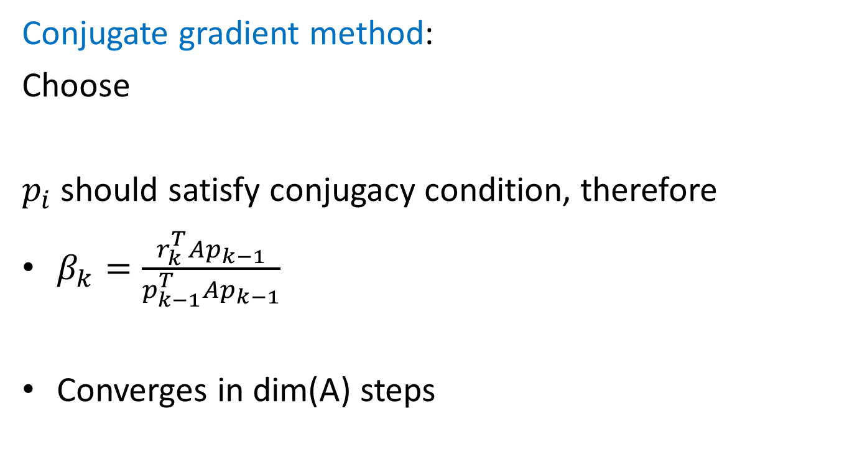
Conjugate Gradient method
Conjugate gradient method:
Choose
$p_{i}$ should satisfy conjugacy condition, therefore
$β_{k}=\frac{r_{k}^{T}Ap_{k−1}}{p_{k−1}^{T}Ap_{k−1}}$
Converges in dim(A) steps

Slide 28
Nonlinear CG method
Idea: Consider general f(x) and substitute r_{k} with ▼f_{k}
Given x₀, f₀, ▼f₀
p₀:=-▼f₀
while ▼f_{k}!=0
compute α_{k}, x_{k+1}=x_{k}+ α_{k}p_{k}
β_{k+1}= (▼f^{T}_{k+1} ▼f_{k+1})/(▼f^{T}_{k} ▼f_{k})
p_{k+1}=- ▼f_{k+1}+ β_{k+1}p_{k}
_{k=k+1}
end

Slide 29
Nonlinear CG method
Converges to local minimum
Much faster than steepest descent in general
Slower than Newton and Quasi-Newton but much less memory

Slide 30
R: Multidimensional optimization
Quasi-Newton and CG incorporated in one procedure
optim(par, fn, gr=Null, method, ...)
Look also
nls(...)

